Slide 1

Research Week 8
Xiaoshu Luo

Slide 2
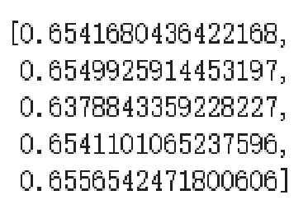
Still working on 7-day concrete strength
Switch from sklearn to Gpy and Trying different kernels
Change the predictor coarse agg to cement
Using the same method for testing the model
(R^2) from a 5-fold cross validation (previously the R2 is about 0.64)

Slide 3
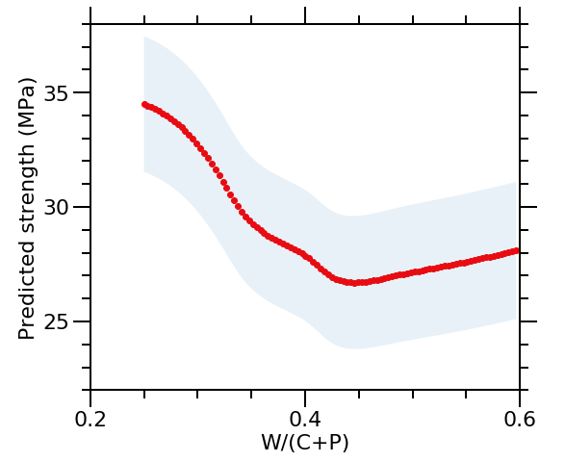
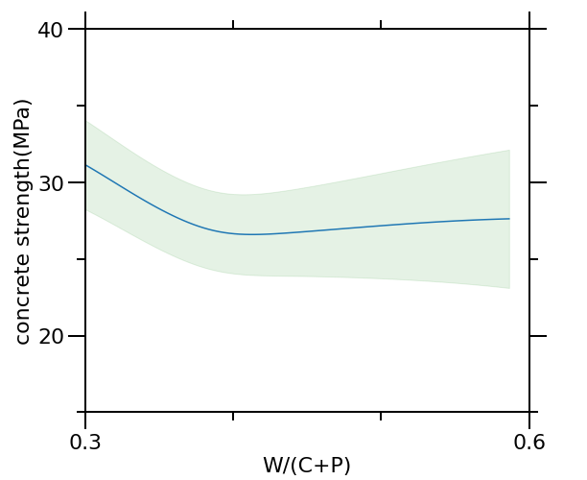
Before and After

Slide 4
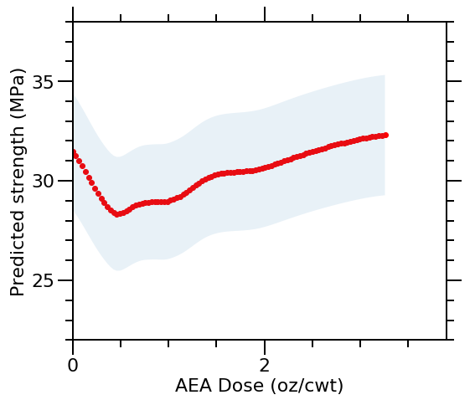
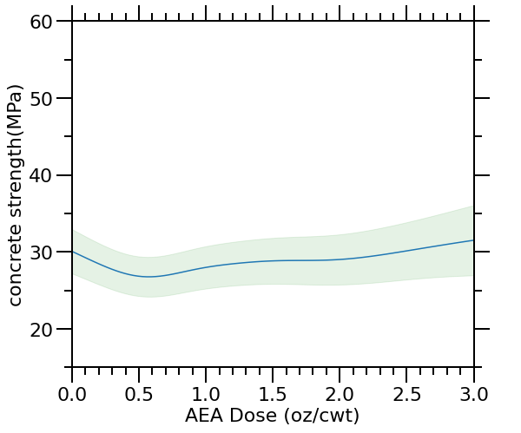
Before and After

Slide 5
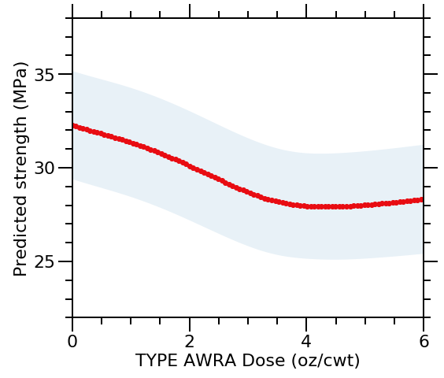
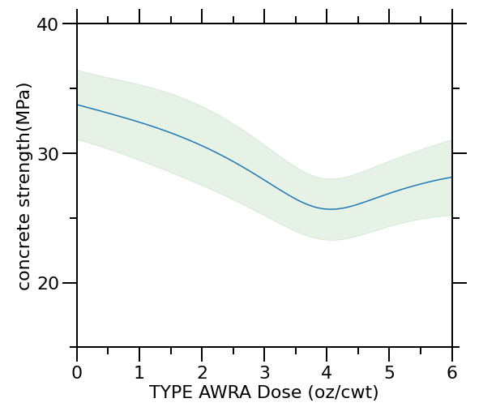
Before and After

Slide 6
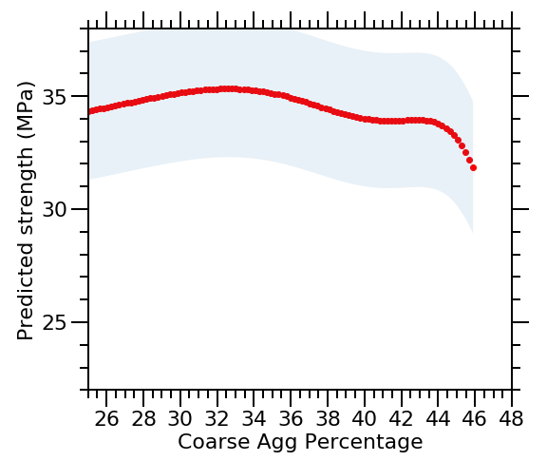
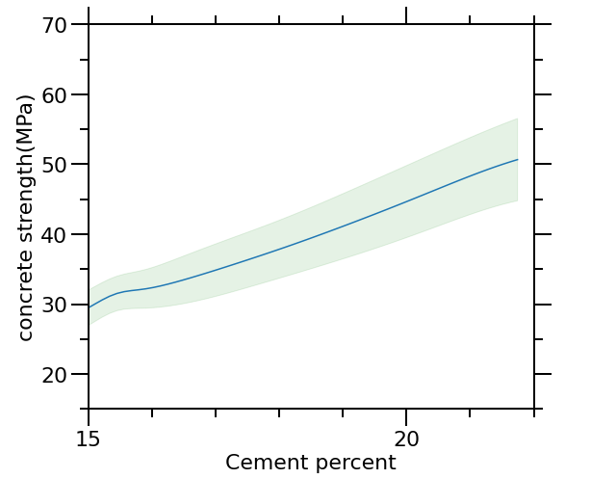
Before and After

Slide 7
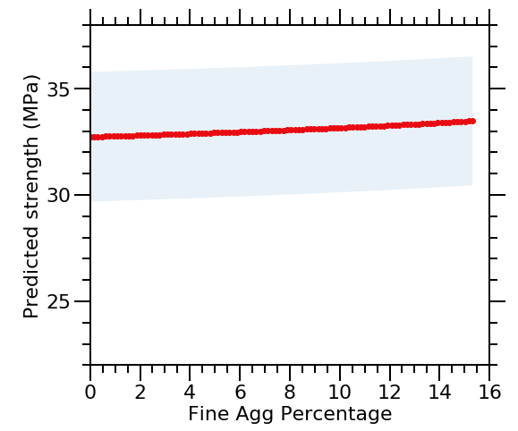
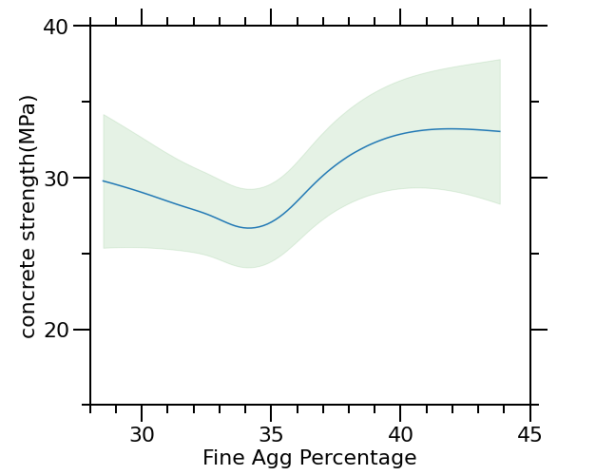
Before and After

Slide 8
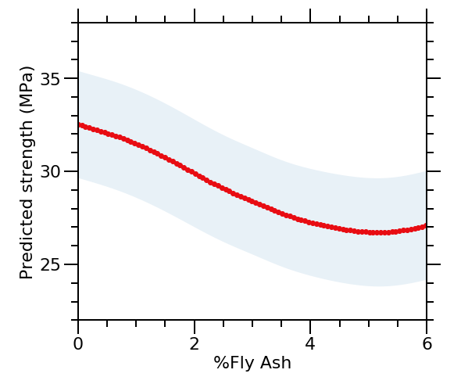
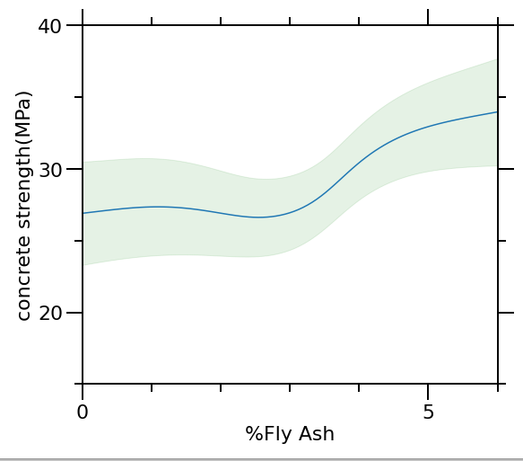
Before and After

Slide 9
Cement
w/c+p
Median 25 75

